Slide 1



Numerical Analysis of Microfluidic devices for lab-on-chip applications
Vishwas Gautam & Samarth Agarwal
Dr. Pankaj Arora
Dr. Vijay Chatterjee

Slide 2
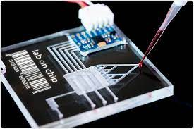
Motivation and Background
What is a microfluidic device?
A microfluidic device is a set of micro-channels etched or moulded into a material (glass, silicon or polymer such as PDMS). The micro-channels forming the microfluidic chip are connected together in order to achieve the desired features (mix, pump, sort, or control the biochemical environment).
Microfluidic devices for Lab-on-chip applications
A lab-on-a-chip (LOC) is a device performing on a miniaturized scale one or several analyses commonly carried out in a laboratory. It integrates and automates multiple high-resolution laboratory techniques such as synthesis and analysis of chemicals or fluid testing into a system that fits on a chip
Lab-On-Chip Device
Microfluidic Devices

Slide 3
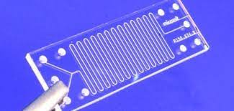
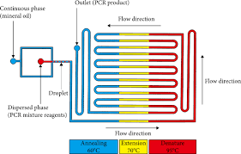
Motivation and Background
Why we need microfluidic devices?
Exploit the physical and chemical properties of fluids at a micro scale. This allows the use of less volume of samples, thereby saving costs.
The compact size of the devices several operations can take place simultaneously and large experiments can be brought down to a very closely packed unit. That’s why an entire laboratory experiment can be brought down to the size of a chip.
Shorten the time of experiment. Due to several operations taking place simultaneously the entire duration of the experiment is brought down to a relatively small duration.
Device for diagnosis of Myeloma
Schematic for PCR microfluidic device
Microfluidic Devices
Notes:
Example for point 1, 2 and 3. If you take blood analysis to test some impurity like cancer cells, or any other external impurity then you can’t use litres of blood just to carry out the experiment. You need to you very tiny amount of blood. In addition to this, you can’t take days to perform the experiments. You would expect the result in minutes or hours. Here, microfluidics devices help a lot

Slide 4
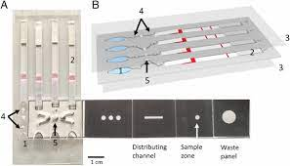
Objectives
To design and simulate a Microfluidic device for quality control
The device will consist of a micro-pump, micro-chamber and a micro-channel.
Basic working principle:
The micro-chamber will contain the fluid for testing and the micro-pump will pump the fluid through the micro-channel. Due the difference in viscosities of the pure and impure fluid, the fluids traverse the micro-channel at two different time periods. This will allow us to differentiate the impurities from the pure fluid.
Low cost device for detection of Malaria
Microfluidic Devices

Slide 5
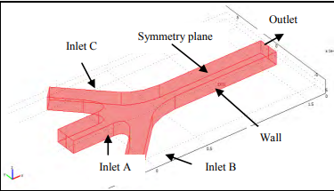
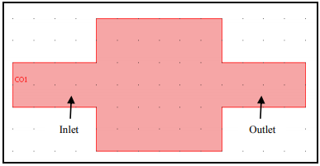
Work done
Understanding the problem statement by reading and
skimming through papers
Read papers on numerical analysis of microfluidic device components such as micro-mixers, micro-chambers, micro-channels, micro-heaters, etc. These devices were modelled and simulated on COMSOL. The resulting concentration distributions and other relevant results were obtained from this.
For example,
The above a three inlet micro-mixer. A micro-mixer is a component of a microfluidic device that allows the stabilized mixing of fluids from several inlets
The above is a micro-chamber that is used for a uniform filling of the fluids.
Microfluidic Devices

Slide 6
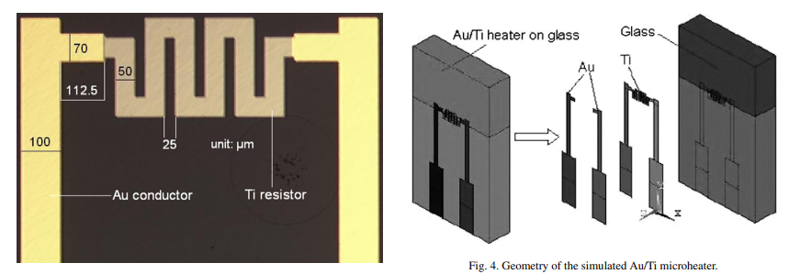
Work done
A thin film gold/titanium (Au/Ti) micro-heater is developed for micro-thruster ignition, micro explosive boiling, and micro sensor applications. The micro-heater was fabricated onto a Pyrex bulk substrate using a micro-fabrication technology. A finite-element based electro-thermal modelling was employed to predict the micro-heater performance. The variations of the micro-heater temperature with time, space, and power supply are determined from the modelling.
Microfluidic Devices

Slide 7
Work done
Understanding the various applications of Microfluidic Devices
Clinical analysis, Blood sampling, DNA analysis, quality control, food analysis, cellonomics, fluid mixing, petroleum testing, etc. Microfluidic device have a wide range applications and different devices suite different applications
Numerical analysis techniques
General overview of numerical techniques and tools such as finite element (FE), finite volume (FV), boundary element, etc. Techniques for computational analysis can be classified by the particular method by which the governing equations for modelling the device are discretized.
Microfluidic Devices

Slide 8
Work done
Introduction to modelling and simulation of microfluidic devices in COMSOL
Designed a simple microfluidic device for capillary driven two-phase laminar flow of air and water. Included surface tension and adhesive forces. Defined wettability between the fluids and the solid surface by giving an appropriate contact angle.
It was single-inlet-single-outlet 2D asymmetric model, consisting of two rectangles and a moving boundary. Decided the inlet and outlet lines.
A time dependent simulation was done keeping velocity and pressure of the channel in mind.
The main agenda was to gain familiarity with COMSOL and it’s interface.
Microfluidic Devices

Slide 9
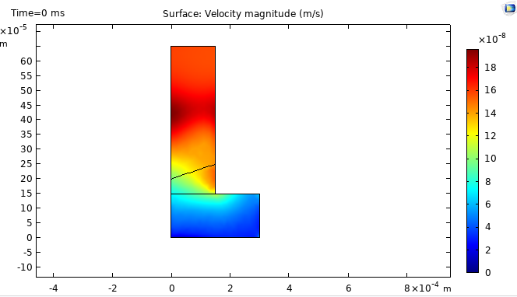
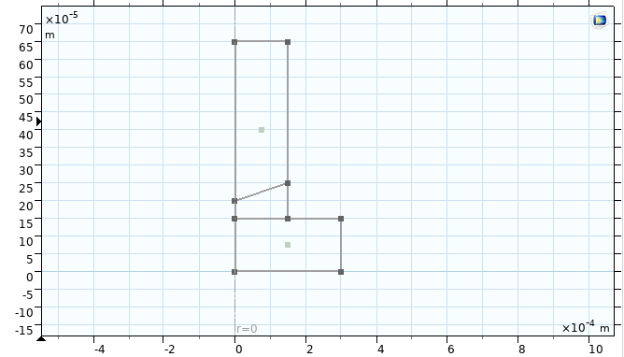
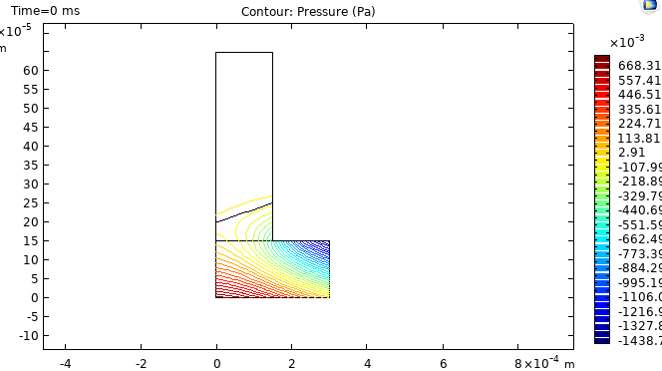
Results and Discussion
The velocity profile after the time dependent study
The model of the microfluidic channel
The pressure profile
Microfluidic Devices

Slide 10
Future Scope
Modelling and simulation of microfluidic devices for quality control in COMSOL
As mentioned in the objective slides, the agenda in the end is to simulate a microfluidic device with a micro-pump, micro-channel, micro-chamber for quality control.
And more insight into microfluidic devices for quality control…
Thank You!
Microfluidic Devices

Slide 11
Chamber
Channel
Pump
A
B

